Slide 1

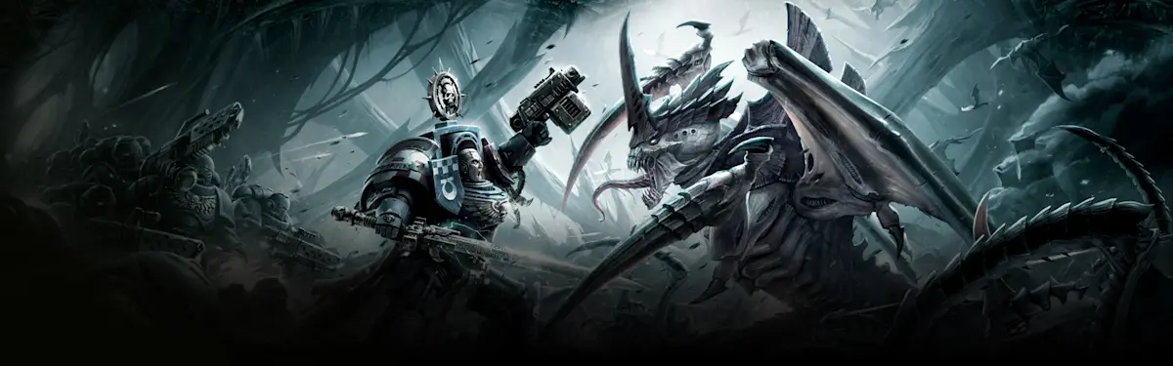
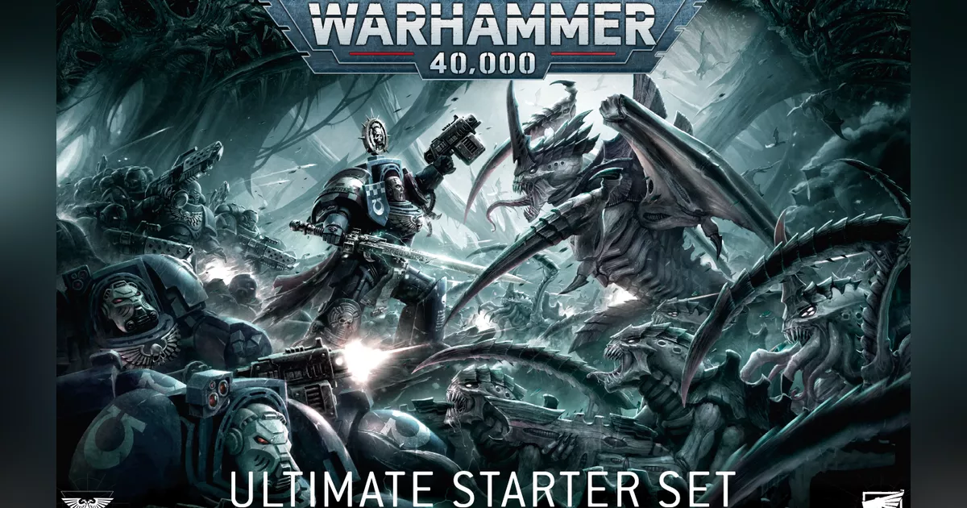

Tournament Analysis
Cesaratto Ilaria - Mezzanzanica Chiara - Porro Andrea

Slide 2

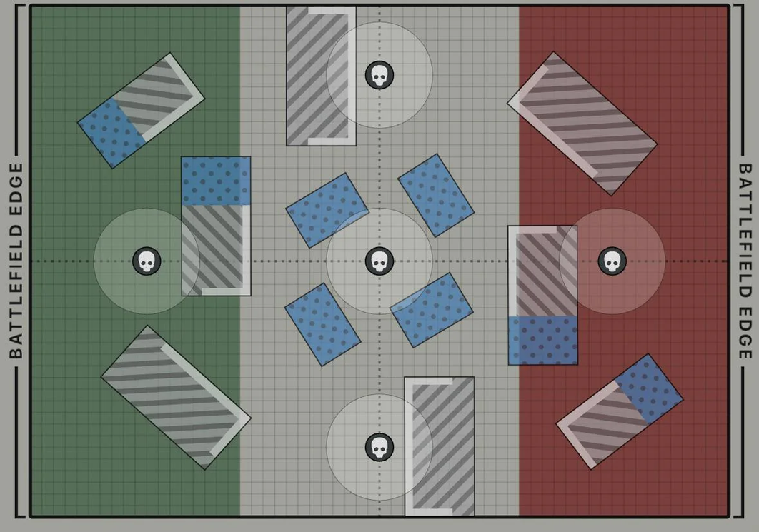

What is warhammer 40k?
It is a tabletop miniature wargame produced by
Game Workshop where players command armies
of intricately detailed plastic miniaturea in tactical
sci-fi battles.
How to build an army:
  Faction
  Detachment
  Units
  Enhancements
  Warlord
Tournament rule and how to to win a game:
  Victory points
  Path to victory

Slide 3
Datasets acquisition
Tournament data:
Extracted from an online repository using a REST API. We developed a custom Python pipeline that worked in four stages:
Price dataset:
Obtained through direct contact with Arsmanufactorea, an official retailer that provided their product catalog.
API_acquisition
parser
parsing
reparser
validator
merger
manual_lists.json

Slide 4
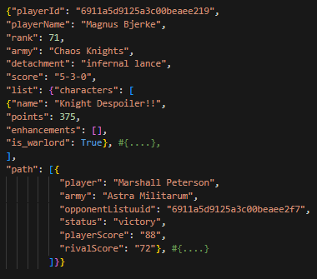
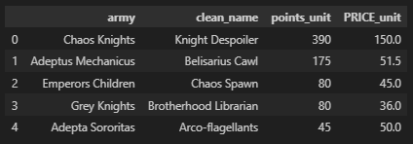

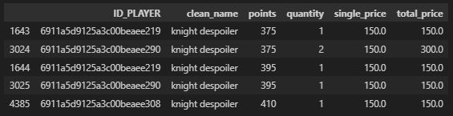
Data Integration
Tournament Data Source (API - JSON)
Pricing Reference Data (Retail - CSV)
Integration Goal: Unit-Level Analytical Dataset
Main challenges:
1
2
Unit name inconsistency and duplication issues
Points - price mismatch
across datasets

Slide 5
1 PROBLEM SOLUTIONS
ST
Unit Name Alignment Across Datasets
  Player-defined naming vs retail product naming
  Systematic text normalization
  Curated mapping dictionary
Pricing Data Deduplication
  Deduplicated pricing reference
  One-to-one join between units and prices ensured

Slide 6
2 PROBLEM SOLUTION
ND
From Points to Prices: Price Estimation
  Retail prices are associated with reference point values
  Tournament units may include upgrades (≤ 40 points)
or a higher number of models in the unit
  Rule-based price scaling
  Economic approximation of army composition

Slide 7



Data Quality Assessment
Data Quality
Before Integration
Data Quality
After Integration
  No price enrichment
  50% unique matches records
  60% unique prices records
  70% standardized unit identifiers
  Referential integrity
  Matches deduplication
  Complete price enrichment
  Deduplicated pricing dataset
  Standardized unit name matching
ACCURACY
+ 30%
COMPLETENESS
REDUNDANCY
CONSISTENCY
100%
- 40%
100%

Slide 8
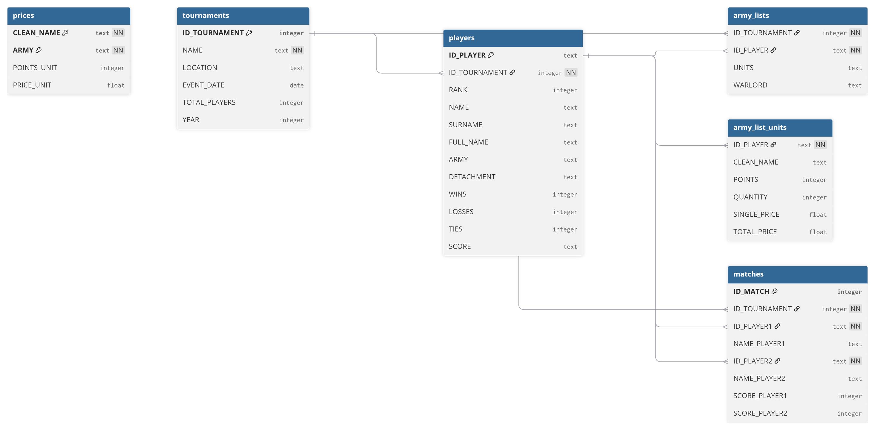
Relational Database Schema
• PK and FK constraints
• Indexes for query optimization
• Scalable to multiple tournaments
• Analysis-ready data model

Slide 9
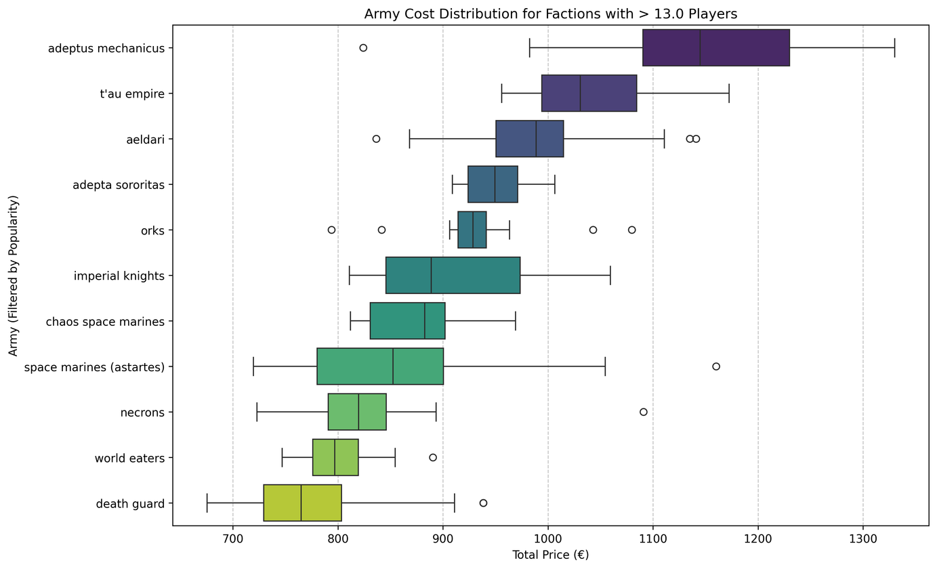
EDA: Understanding the battlefield
Army Cost: Economic Disparity
Army cost distribution output
The analysis shows a strong economic disparity between the most popular factions, with cost differences of up to four hundred euros, suggesting that the actual cost may influence the choice of faction and its popularity.

Slide 10
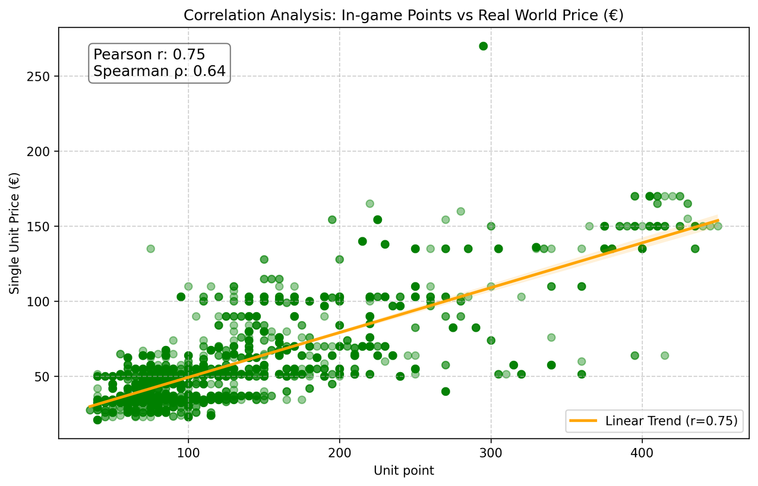
EDA: Understanding the battlefield
Price to point ratio
Correlation analysis
This result raises the question of whether differences in economic investment may indirectly affect competitive viability, suggesting the presence of potential pay-to-win dynamics within the meta

Slide 11
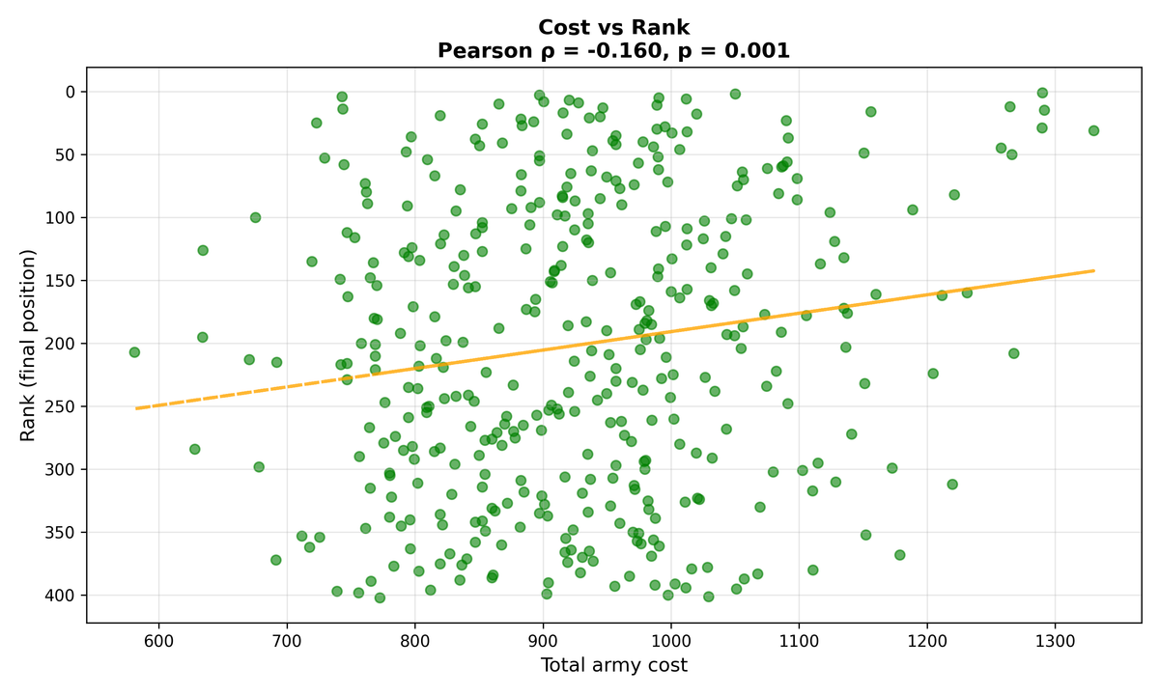
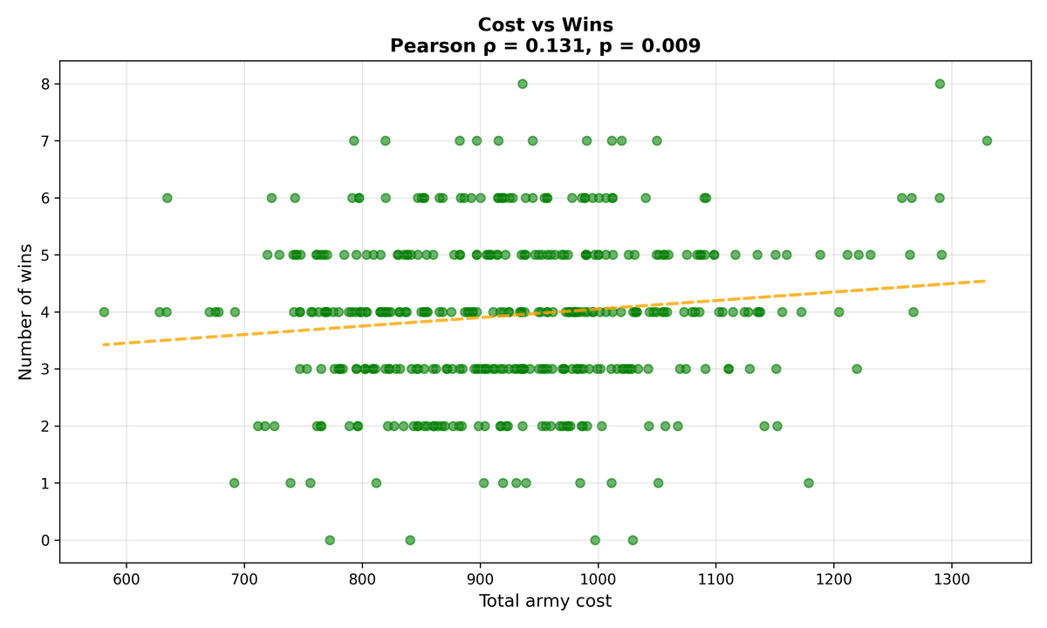
Economic Analysis - Is it "Pay-to-Win"?
Scatterplot: cost vs rank
Scatterplot: cost vs win
Better rank with higher cost
More wins with higher cost
Investment provides a marginal competitive edge, but represents only a minor factor in the final outcome.

Slide 12
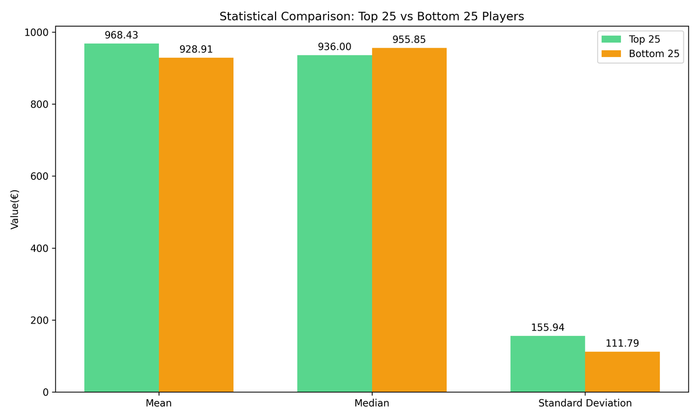
Economic Analysis - The "Elite" Barrier
Descriptive statistics
Metrics | Top 25 players (Rank 1-25) | Bottom 25 players (Rank 377-402)
Average cost | 968.43 | 928.91
Median cost | 963.00 | 955.85
Standard deviation | 155.94 | 111.79
Minimum cost | 723.00 | 739.00
Maximum cost | 1291.50 | 1110.75
Performance vs cost overview
In competitive tournaments, there is no statistical evidence that a higher budget is required to reach the top tier (p>0.05). At this level, success is driven by Skill and Strategy, not investment.

Slide 13
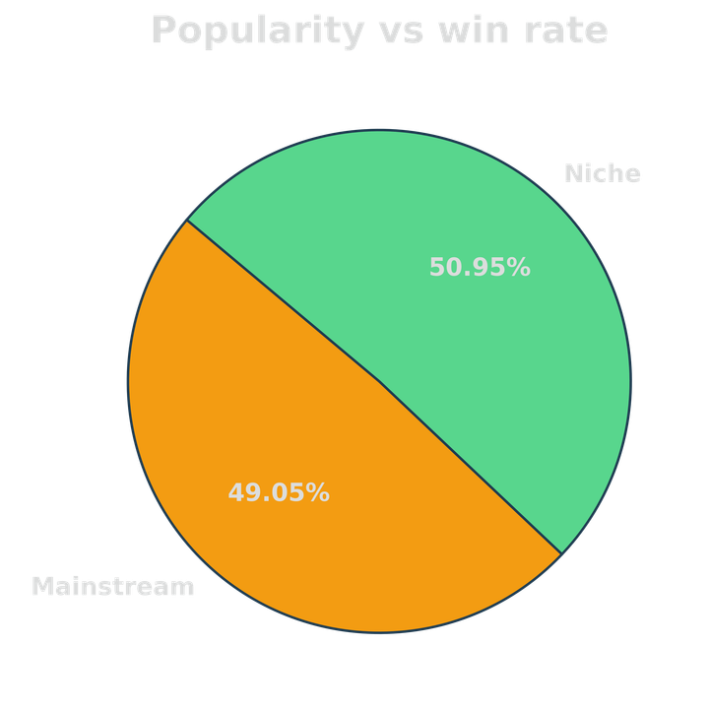
Meta Analysis – Popularity vs Performance
Correlation analysis
Popularity vs win rate | Result
Pearson correlatio (r) Pearson p-value | 0.0007 0.9974
Spearman correlatio (ρ) Spearman p-value | -0.0538 0.7898
Popularity vs rank | Result
Pearson correlatio (r) Pearson p-value | 0.0138 0.9454
Spearman correlatio (ρ) Spearman p-value | 0.1666 0.4062
The sample size for "Niche" factions is small (< 15 players). This high variance means results could be skewed by individual player skill. A larger dataset (N>30 per faction) is required for definitive confirmation.

Slide 14
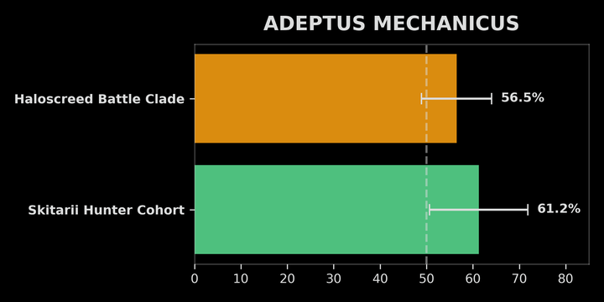
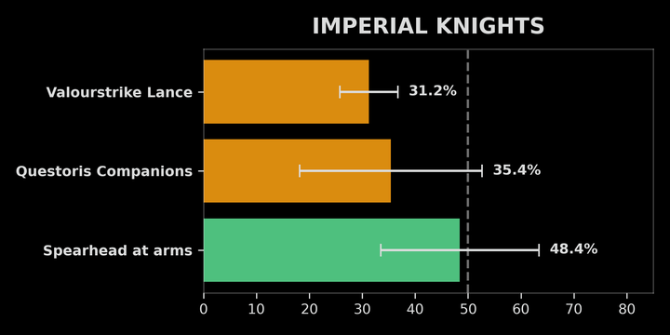
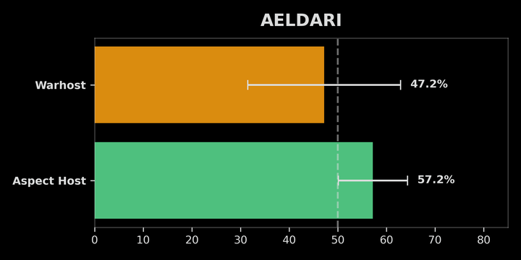
Meta Analysis – The Micro Level
Detachment analysis
Detachment overview
Adeptus Mechanicus | Win rate | 95% CI
Skitarii Hunter Cohort Haloscreed Battle Clade | 61.25% 56.47% | ±10.62% ±7.53%
The real competitive edge is found at the 'Micro' level. Optimizing the sub-faction offers a structural advantage of +10% to +17%, making it mandatory for success.
Imperial Knights | Win rate | 95% CI
Spearhead at arms Questoris Companions Valourstrike Lance | 48.44% 35.42% 31.25% | ±14.96% ±17.23% ±5.48%
Aeldari | Win rate | 95% CI
Aspect Host Warhost | 57.24% 47.22% | ±7.09% ±15.70%%

Slide 15
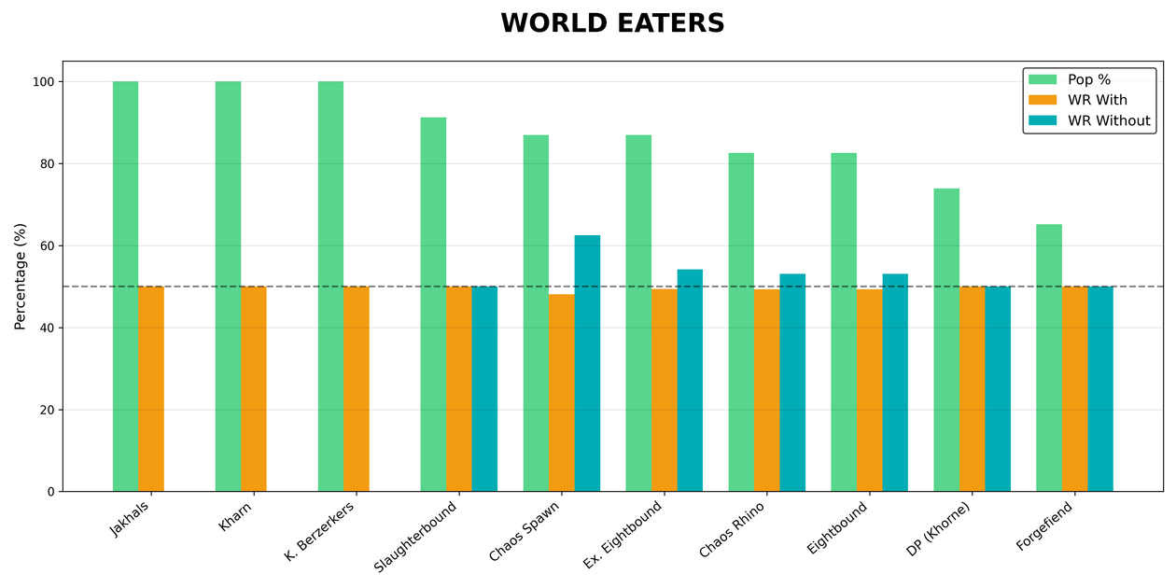
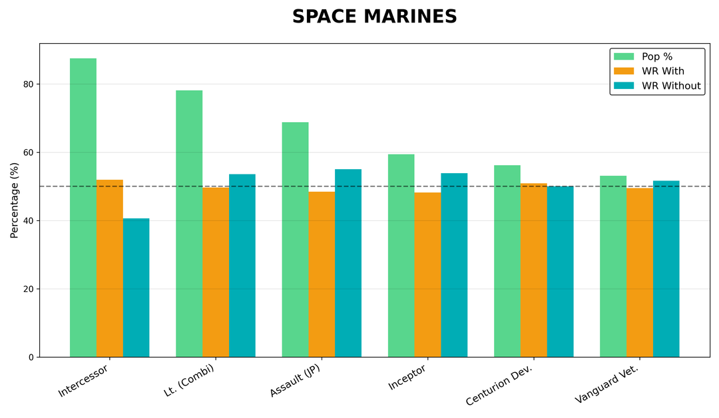
Unit Analysis – The "Core" Units
UNIT IMPACT: POPULARITY, WIN RATE WITH, WIN RATE WITHOUT
The lack of relevance is due to the sample: units such as Jakhals (100% usage) are used by all players, both tournament winners and participants with the lowest scores. For this reason, their performance naturally converges towards the faction average. However, such extensive use confirms their status as “indispensable elements” for army building.

Slide 16
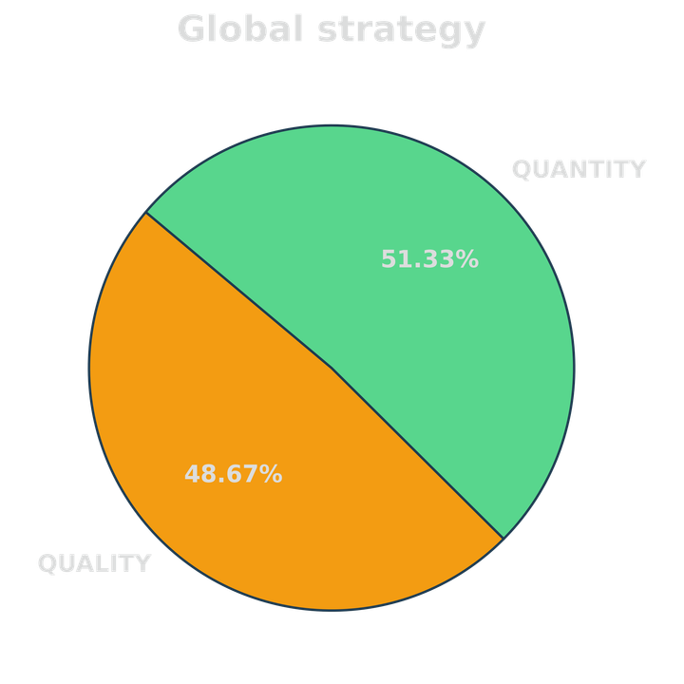
Unit Analysis – Quality vs Quantity
Strategy comparison for factions
ARMY | STRATEGY | WIN RATE
Space marines | QUALITY QUANTITY | 50.00% 51.00%
Aeldari | QUALITY QUANTITY | 60.83% 45.98%
Adeptus mechanicus | QUALITY QUANTITY | 58.29% 58.93%
World Eaters | QUALITY QUANTITY | 51.25% 49.04%
Death Guard | QUALITY QUANTITY | 42.05% 42.11%
Overall, the game does not favor elite over horde. However, specific factions (like Aeldari) have strict playstyle preferences that must be respected to be competitive.

Slide 17
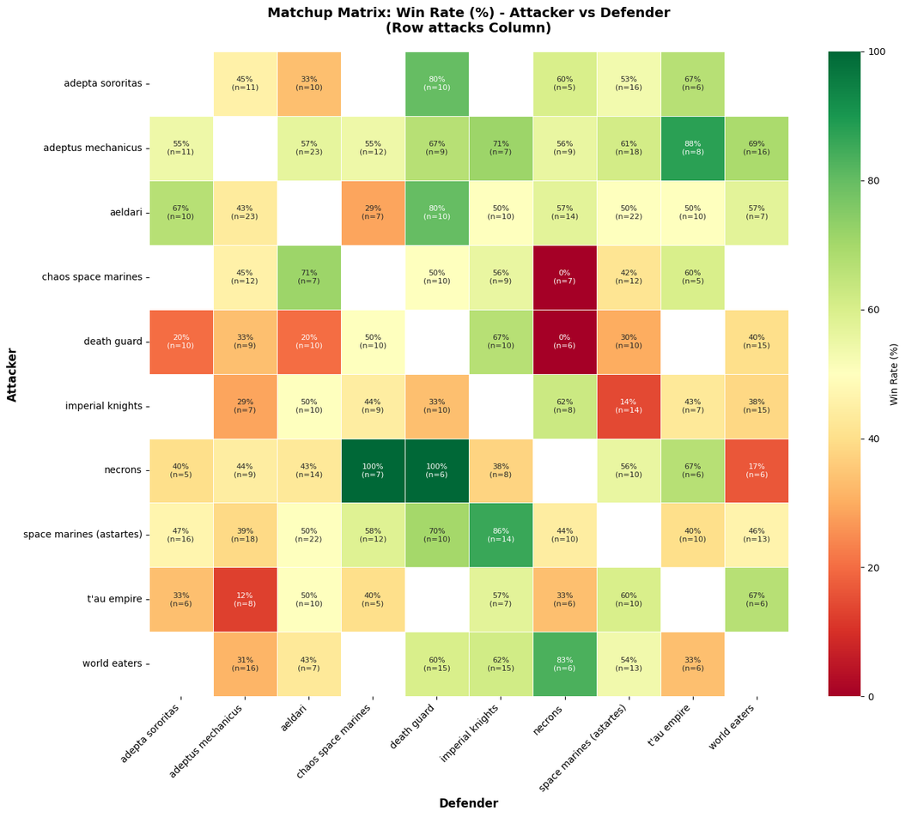
Faction Dynamics – Matchup Analysis
Matchup Matrix: Win Rate (%)
  40 pairwise matchups analyzed (Top 10 factions)
  Only 3 matchups statistically significant (p < 0.05)
  Several directional trends (>60% / <40% WR)
  Presence of hard and soft counters
  Necrons show the most polarized performance (hard counters)
  Space Marines dominate Imperial Knights despite lower unit cost
  Aeldari matchups are mostly balanced (skill-driven outcomes)

Slide 18
Limitations
Future work
Analysis limited to the 2025 World Championship due to frequent balance updates, reducing generalizability and statistical power in matchup and detachment results
Army costs are inferred, not actual player expenses
The unit-name dictionary is tailored to this event and may not generalize
Expand the dataset by extracting data from additional tournaments, properly handling balance changes over time and the release of new units
Develop an army building interface that allows users to evaluate army potential competitive performance by identifying, through a maximum-similarity matching system, the most comparable army
&

Slide 19
Tournament Analysis
Cesaratto Ilaria - Mezzanzanica Chiara - Porro Andrea

